Slide 1
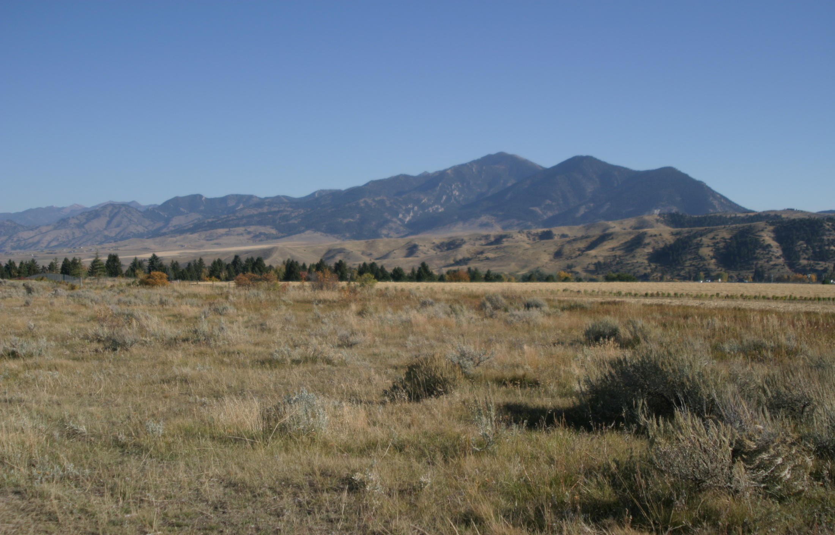
Cooperative Invasive Species Management Areas:
Resources and Support
Janet Clark
Center for Invasive Plant Management, Bozeman, MT

Slide 2
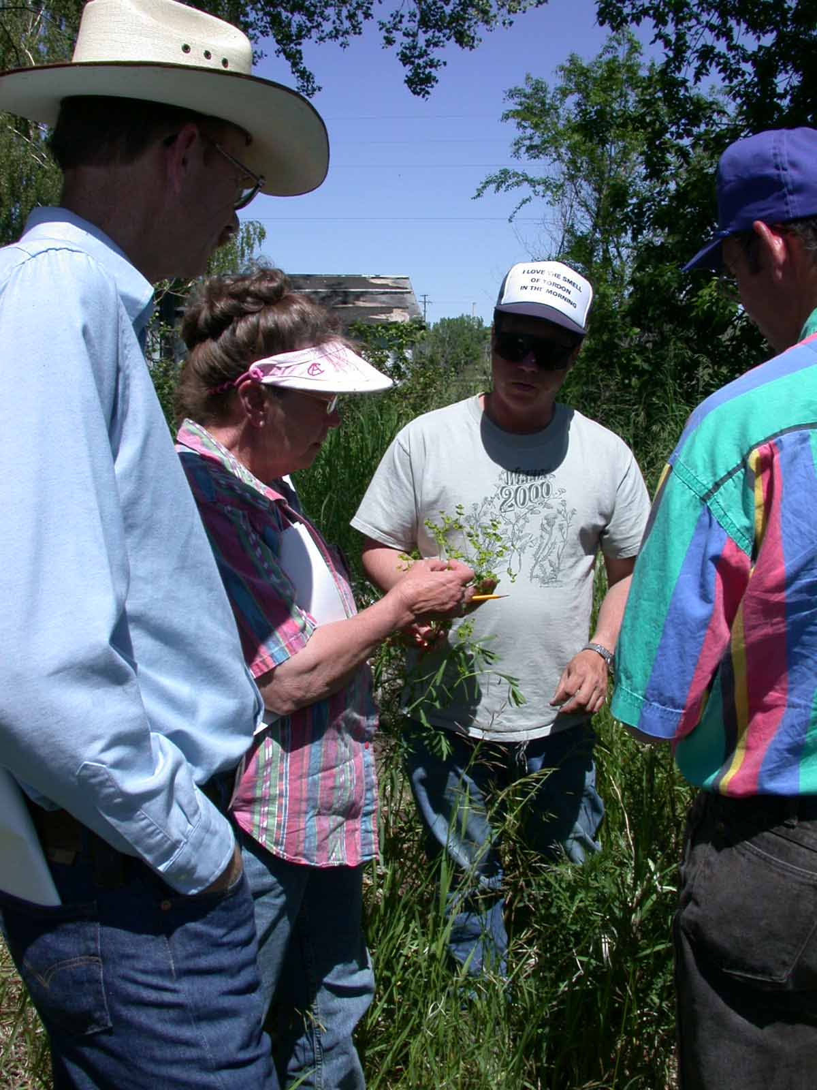
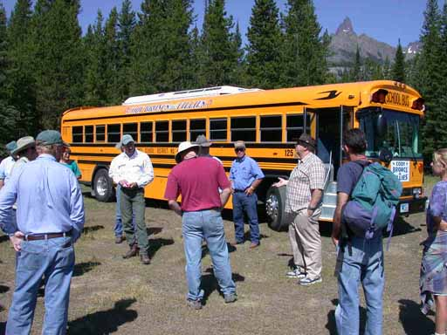
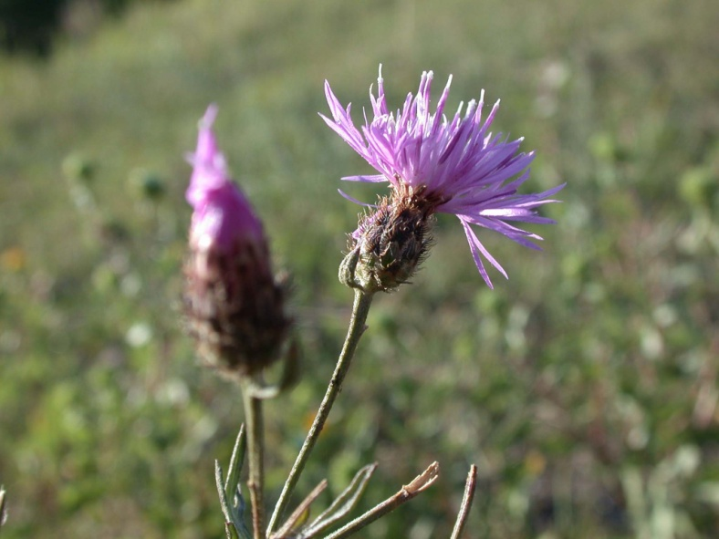
Partnerships

Slide 3
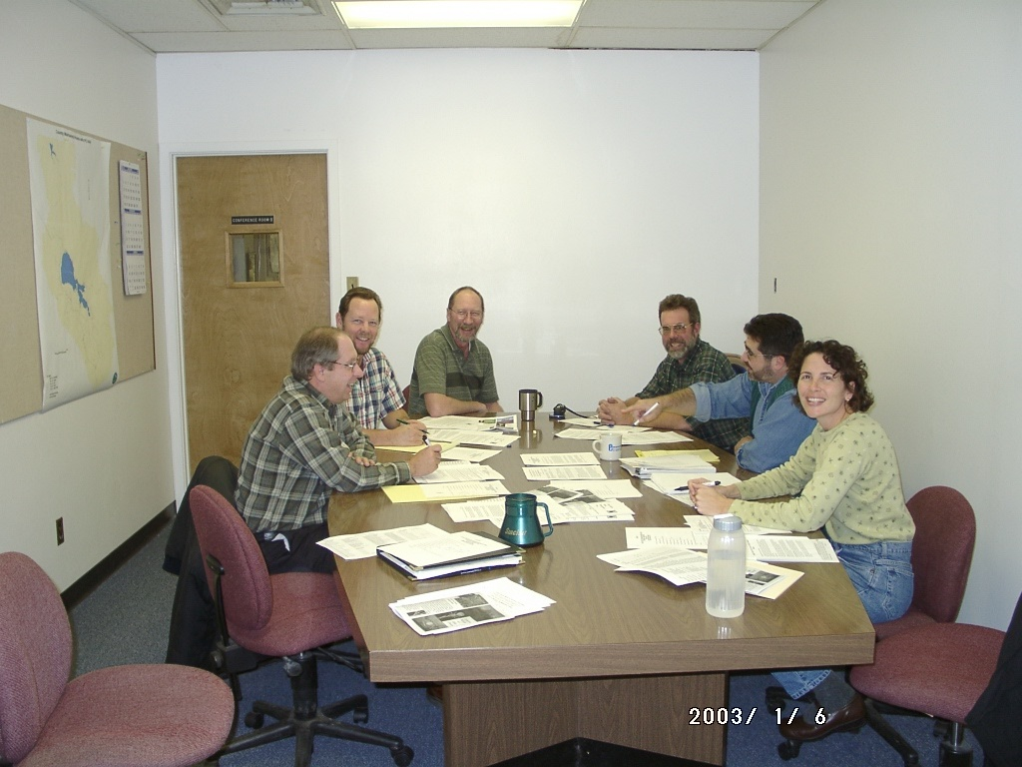
Partnerships:
Challenges and Benefits
Partnerships require:
Time
Compromise
Workers as well as bosses and “idea people”
Someone to be accountable

Slide 4
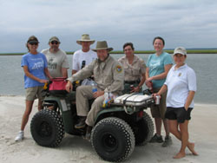
Partnerships:
Challenges and Benefits
Partnerships offer:
Wide range of skills and abilities
More resources (funding, equipment, time)
Increased project credibility and visibility
Better ideas – “two heads are better than one”

Slide 5
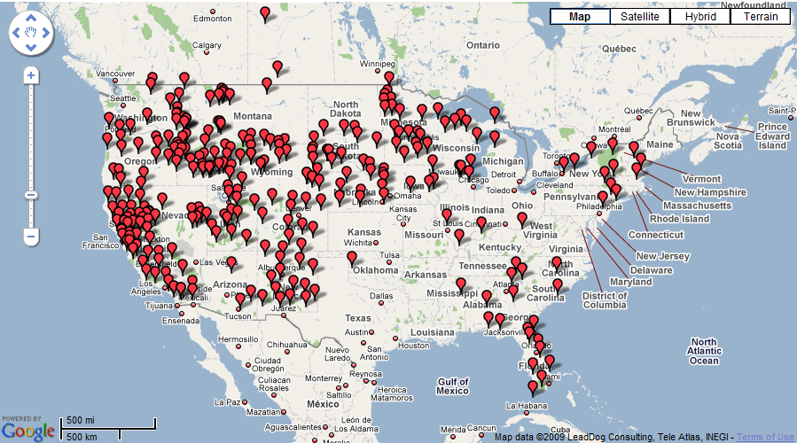
Cooperative Weed/Invasive Species Management Areas
www.nnipc.org

Slide 6
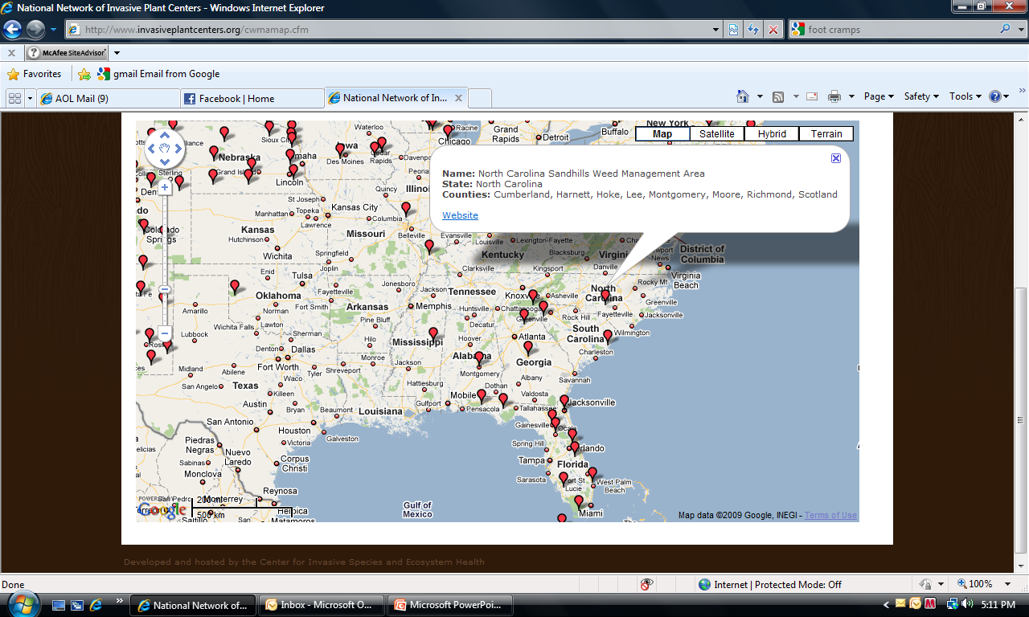
Cooperative Weed/Invasive Species Management Areas
www.nnipc.org

Slide 7
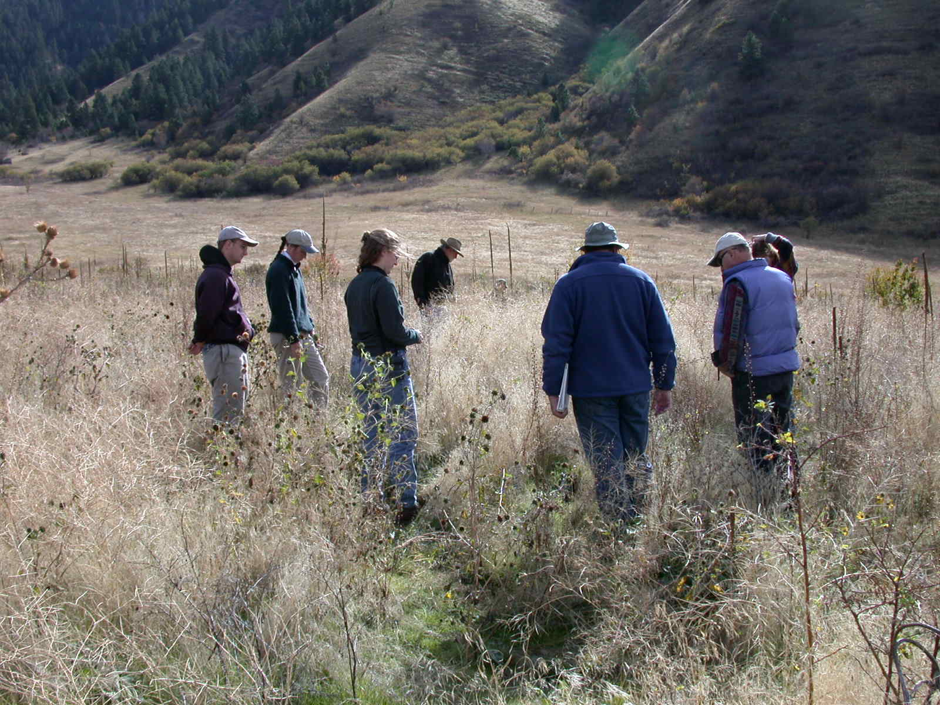
What is a CWMA/CISMA?
Cooperative Weed/Invasive Species Management Areas
A partnership of federal, state, and local government agencies, tribes, individuals, and various interested groups that manage noxious weeds or invasive plants in a defined area.*
* Endorsed by the Western Weed Coordinating Committee, 2006

Slide 8
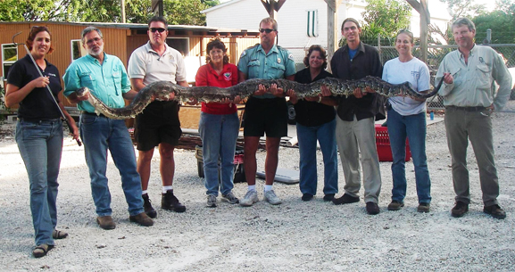
Characteristics of a CWMA/CISMA
Defined geographical area
Representation of the majority of landowners
Steering committee
Commitment to cooperation
Comprehensive plan

Slide 9

What do they do?
Collaborate, share responsibilities and resources
Develop a management plan
  Objectives – What is the goal?
  Inventory – What is the status today?
  Management – What are the priorities? Options?
  Prevention/EDRR
  Control
  Restoration
  Education & Outreach – Who needs
  to be on board?
  Logistics – authority, finances,
  communications, reporting
Coordinate action
Evaluate and adapt

Slide 10

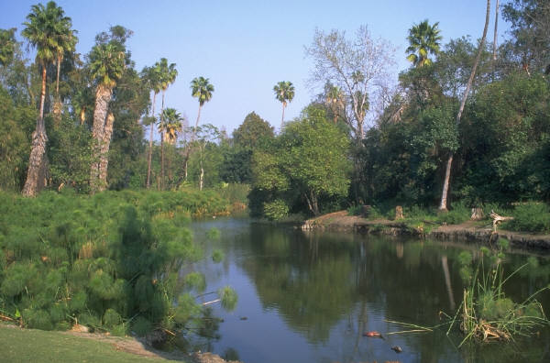


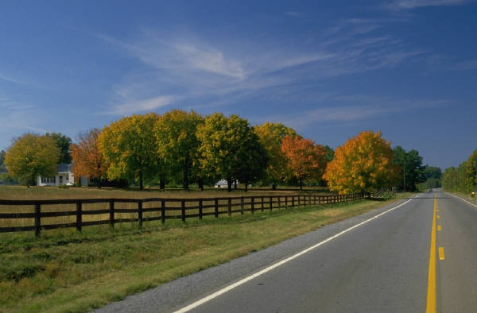
Diversity
Geographical variation
Infrastructure for IS management
State laws
State management plans, IS Councils
Population
Culture
Politics

Slide 11

Who’s involved?
Private landowners, volunteers, youth
Federal agencies:
  Fish & Wildlife Service
  Army Corps of Engineers
  Dept. of Defense
  National Park Service
  USDA-NRCS
State agencies:
  Fish & Wildlife
  Natural Resources
  Agriculture
  Transportation
Non-governmental organizations:
  The Nature Conservancy
  Livestock interests
  Exotic Pest Plant Councils
Counties
Universities
Anyone who’s interested!
Notes:
See http://www.elachee.org/Preserve/CWMA%20brochure.pdf

Slide 12
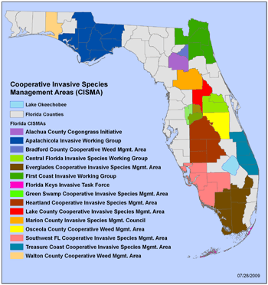
CISMAs in Florida
Florida Invasive Species Partnership
www.floridainvasives.org

Slide 13
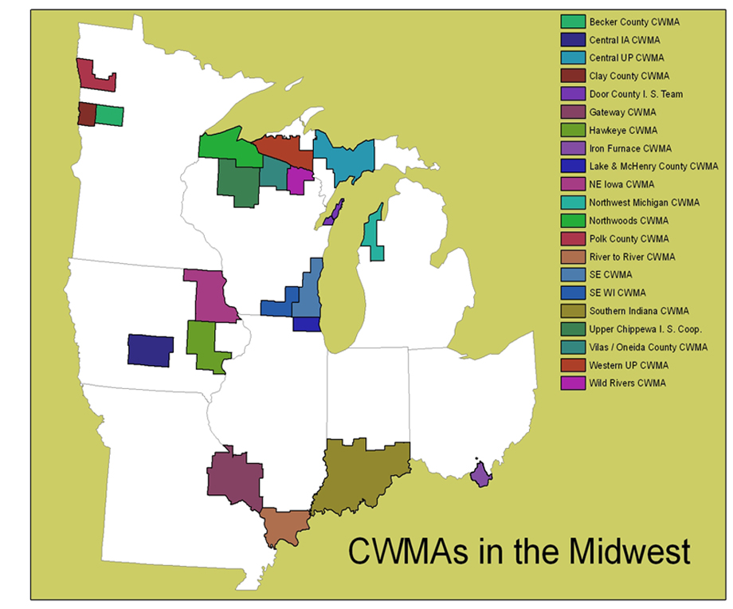
CWMAs in the Midwest
Midwest Invasive Plant Network
www.mipn.org

Slide 14
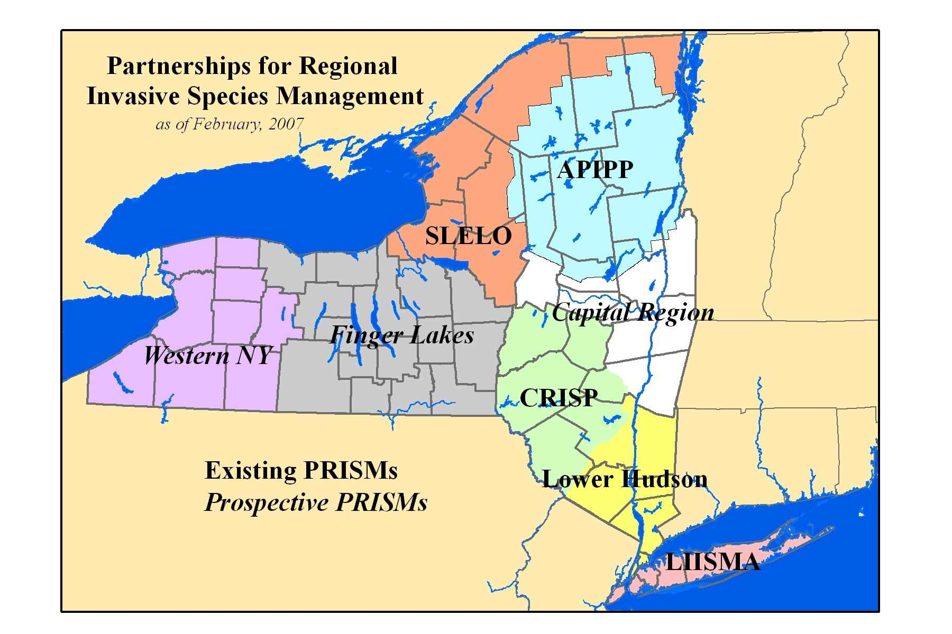
PRISMs in New York
NY Dept. of Environmental Conservation

Slide 15
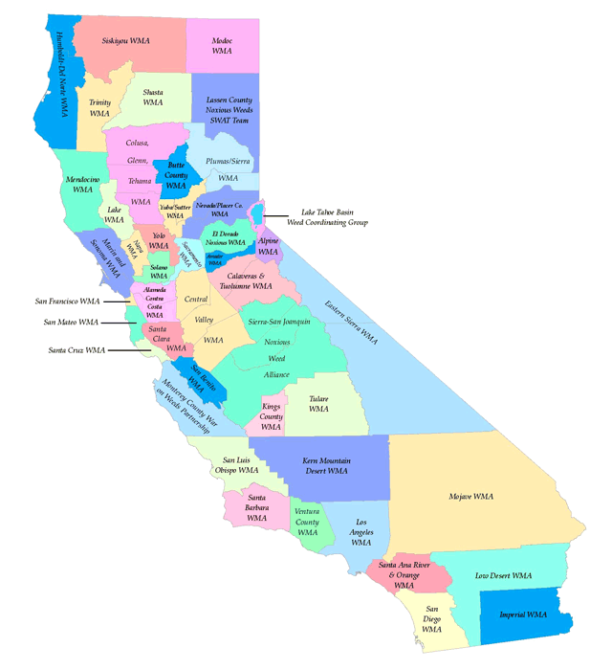
WMAs in California
California Invasive Plant Council
www.cal-ipc.org

Slide 16
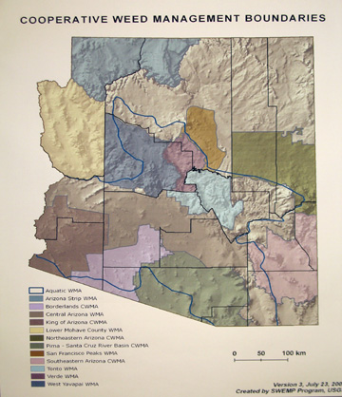
CWMAs in Arizona
Southwest Vegetation Management Association
www.swvma.org

Slide 17
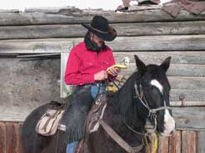


Weed Prevention Areas in Montana
Pride of place
Newspaper ads
“Weed-Free Rangelands and Wildlife Habitat” brochures for hunters
Weed-free hay
Summer range riders
GPS units for ranchers

Slide 18
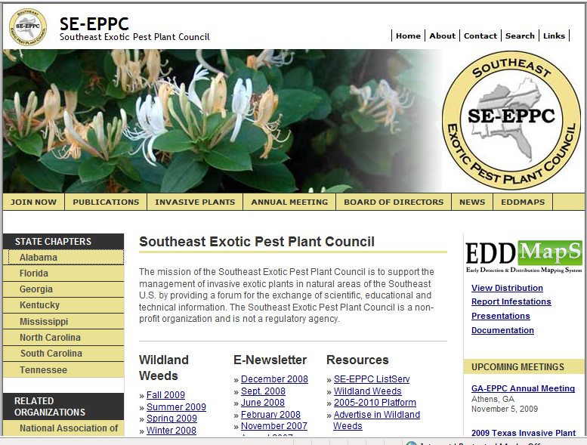
Exotic Pest Plant Councils (EPPCs)
Alabama
Florida
Georgia
Kentucky
Mississippi
North Carolina
South Carolina
Tennessee
http://www.se-eppc.org/
Notes:
Where to go for contacts & info???

Slide 19
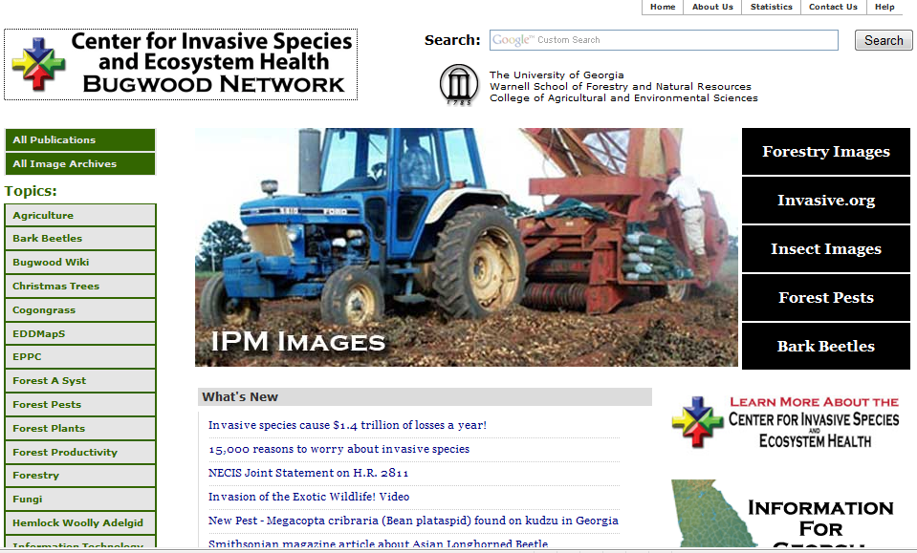
Center for Invasive Species & Ecosystem Health
Why?
  Huge photo gallery
  Mapping resources (EDDMapS)
  Website development
  www.bugwood.org

Slide 20

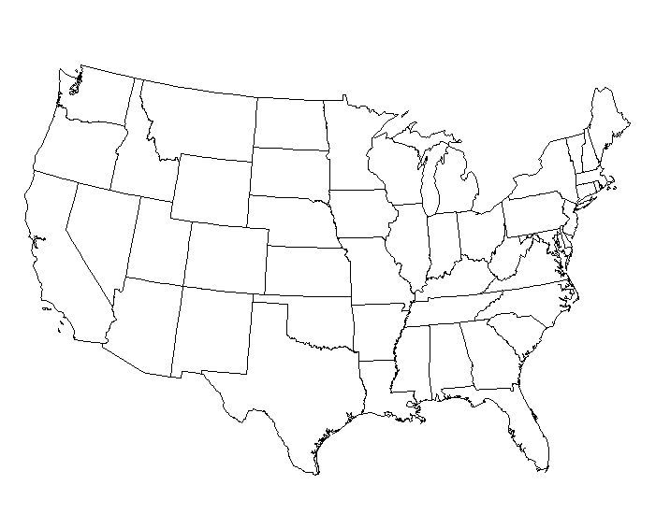

Center for Invasive Plant Management western regional clearinghouse
Why?
  www.weedcenter.org
  Resources for CWMAs
  List of funding opportunities

Slide 21

State universities
Why?
  Extension specialists, educational material
  Research projects
  Collaborations

Slide 22


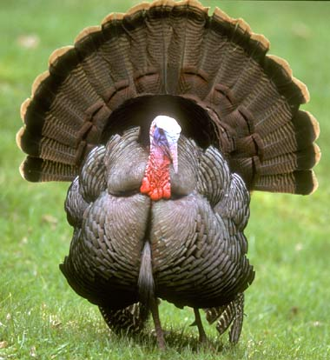
Non-governmental organizations
Why?
  State wildlife management plans
  Passion and commitment
  Different approaches to resource mgmt

Slide 23


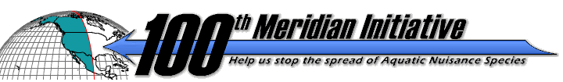
Aquatic Nuisance Species Task Force
Gulf and South Atlantic Regional Panel
Mid-Atlantic Regional Panel
Why?
  Regional planning and partnerships
  Education & outreach resources
  www.anstaskforce.gov

Slide 24
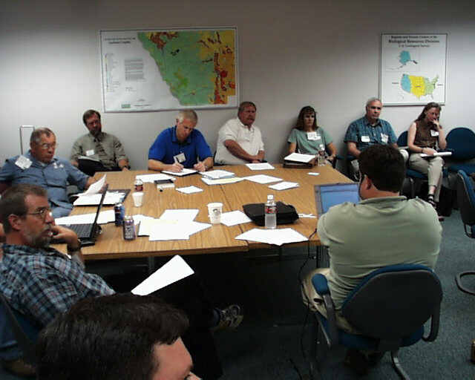
Federal Interagency Committee for the Management of Noxious and Exotic Weeds
Why?
  Dept. of Defense represented
  Multi-agency information exchange and
  problem-solving at monthly meetings

Slide 25
National Invasive Species Council
Why?
  Coordinates Federal response through the
  National IS Management Plan
  www.invasivespecies.gov

Slide 26

National Invasive Species Awareness Week
Jan. 10-14, 2010, in Washington, DC
  Invasives and climate change
  Invasives and energy & biofuels
  Invasives and the “green” economy
www.nisaw.org

Slide 27

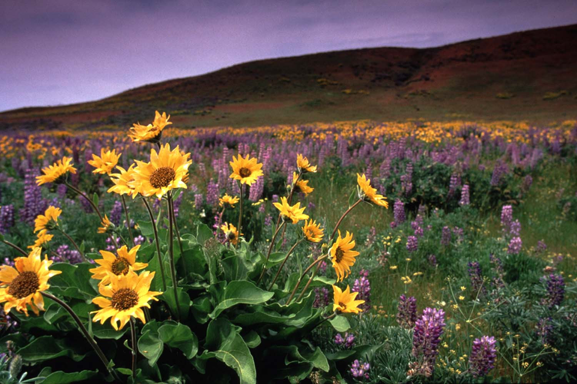
www.weedcenter.org
janet.clark@montana.edu

