Slide 1

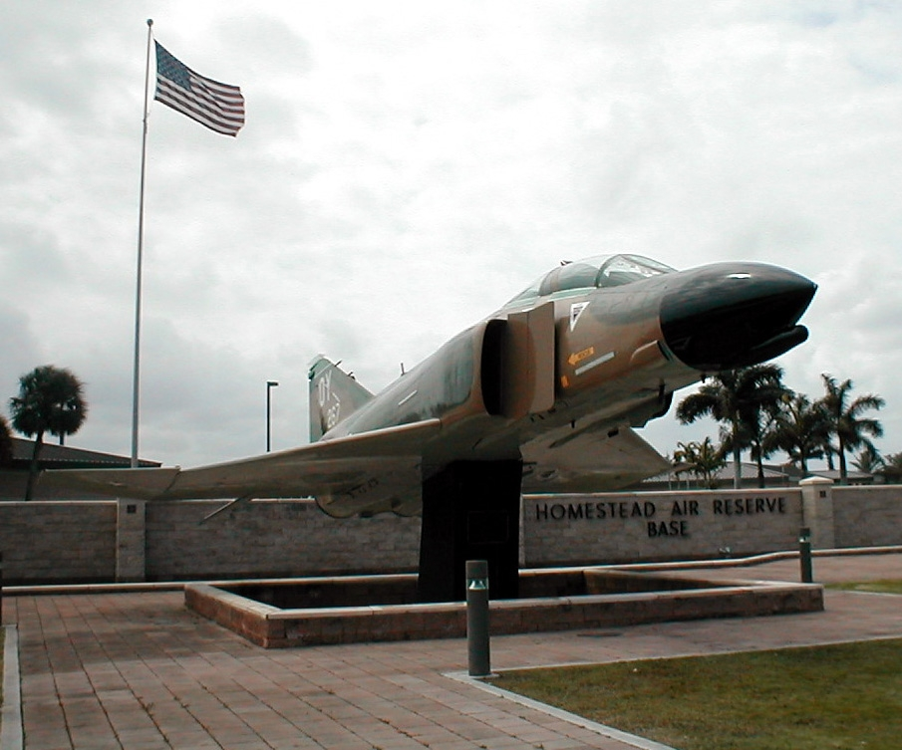

482 Fighter Wing
Cooperative Work with National Park Service in dealing with Nile Monitors at HARB
Michael J. Andrejko PhD
EIAP/IRP/MMRP/Natural Resources
Program Manager

Slide 2

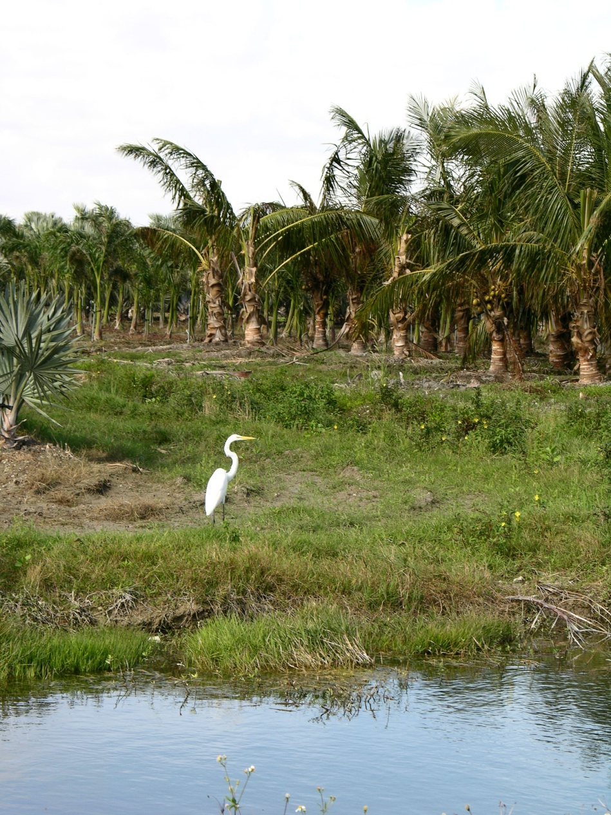
Homestead ARB:
Unique Environmental Location/Setting
Located in far southern part of Miami-Dade Co.
Approx. 2 miles from Biscayne Bay
Between two National Parks (BNP, ENP)
Along major migratory bird flyway
Subtropical meteorological conditions
Low elevation, very flat topography
Water table at/near ground surface
Wetland complexes on Base

Slide 3
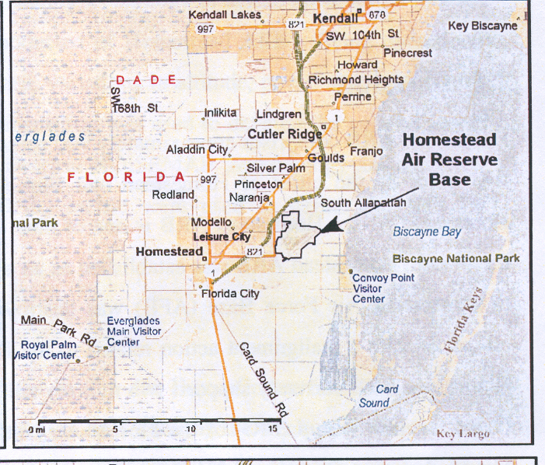

Slide 4
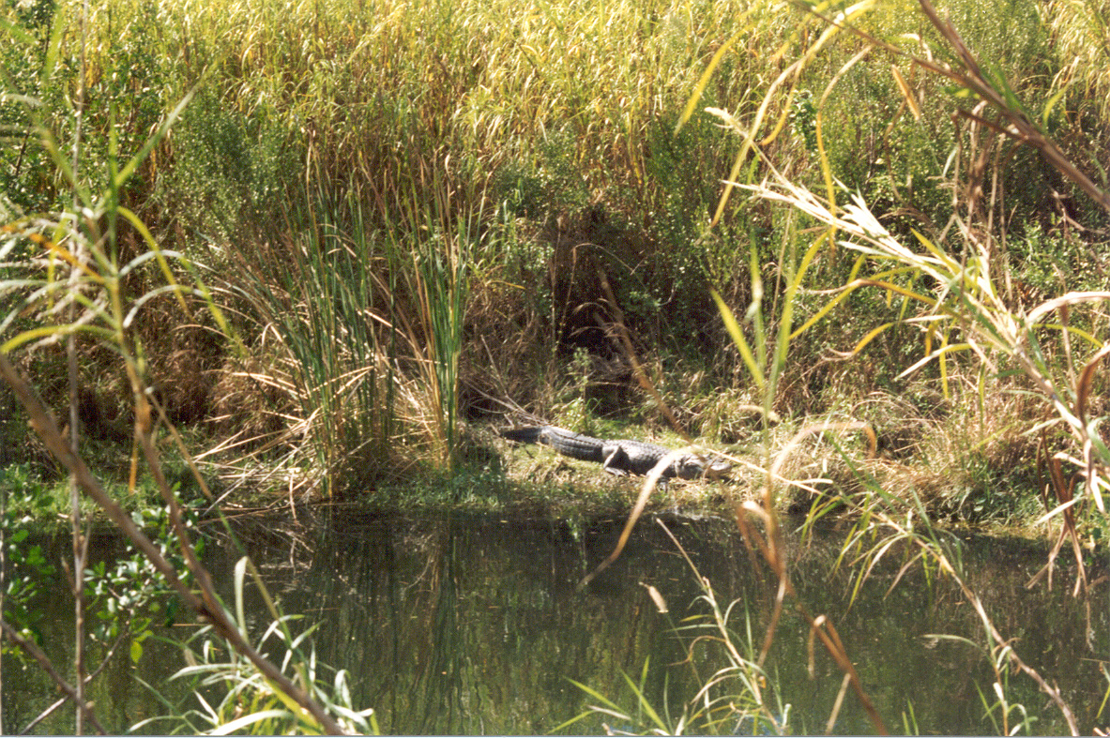
Invasive Species Include:
Plants
Birds
Reptiles
Mammals
Fish

Slide 5
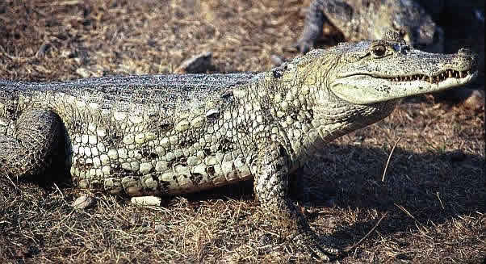
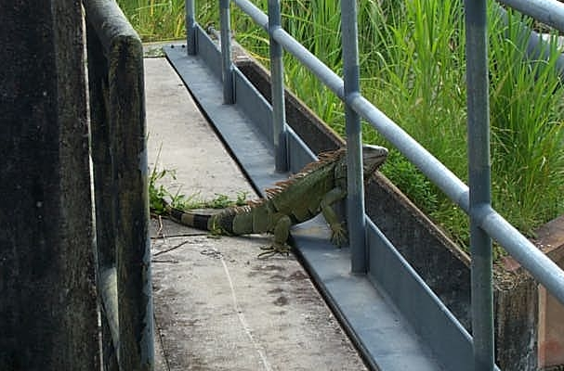
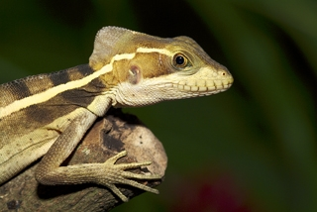
Invasive Reptiles
Examples:
  Spectacled Caiman
  Monitor Lizard
  Great Green Iguanas
  Burmese Pythons
  Basilisk (“Jesus”) Lizards
  Many Gecko species (e.g., Bahamian)
  Red-headed Agamas

Slide 6
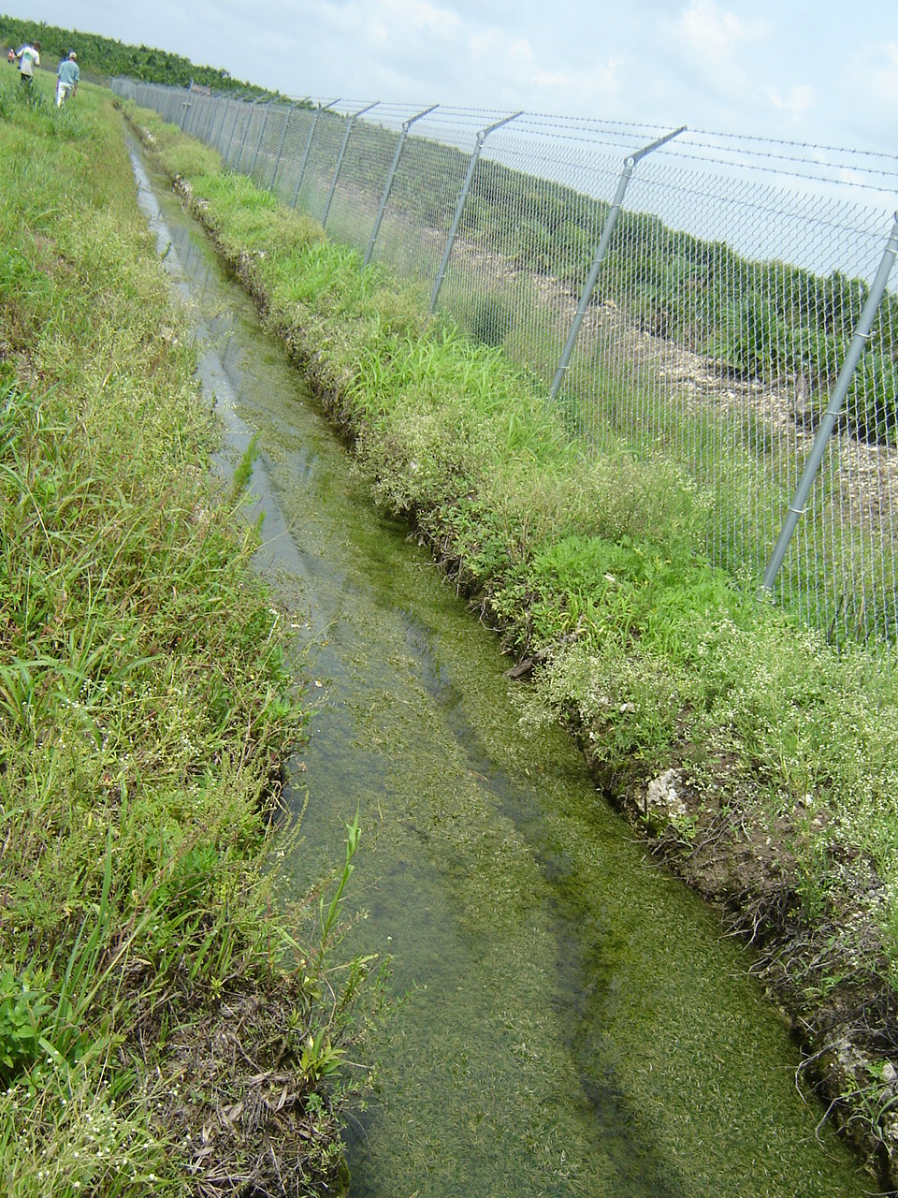
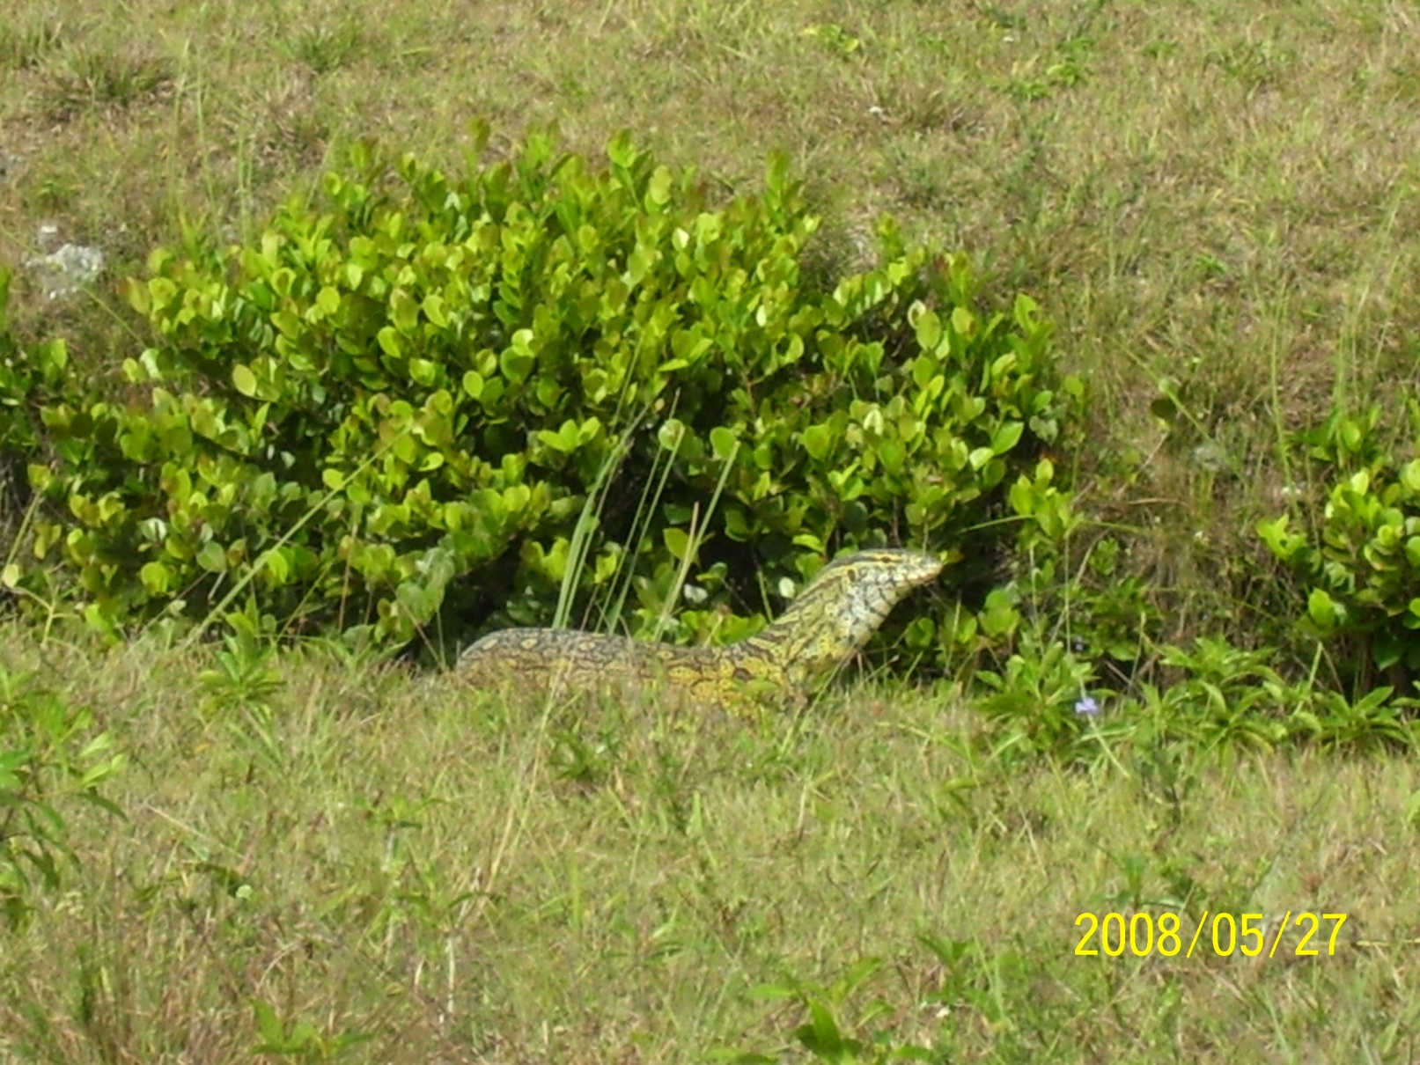
Base Recon Response to Sightings

Slide 7
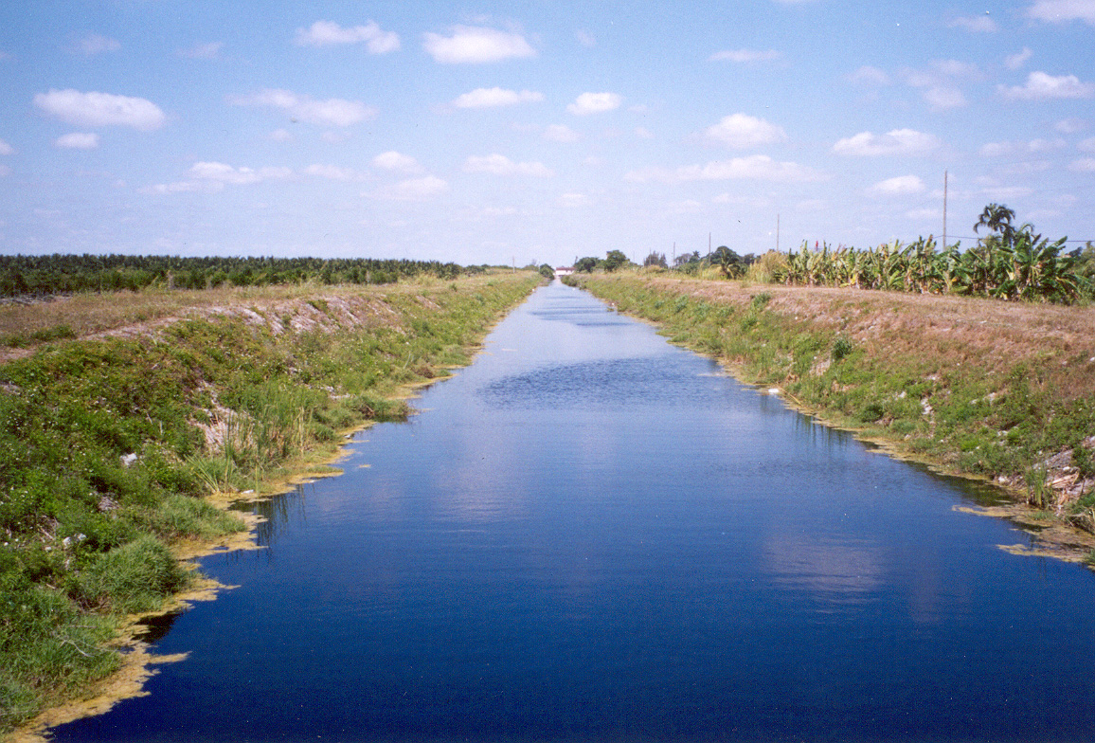
Military Canal Possible Conduit to BNP

Slide 8
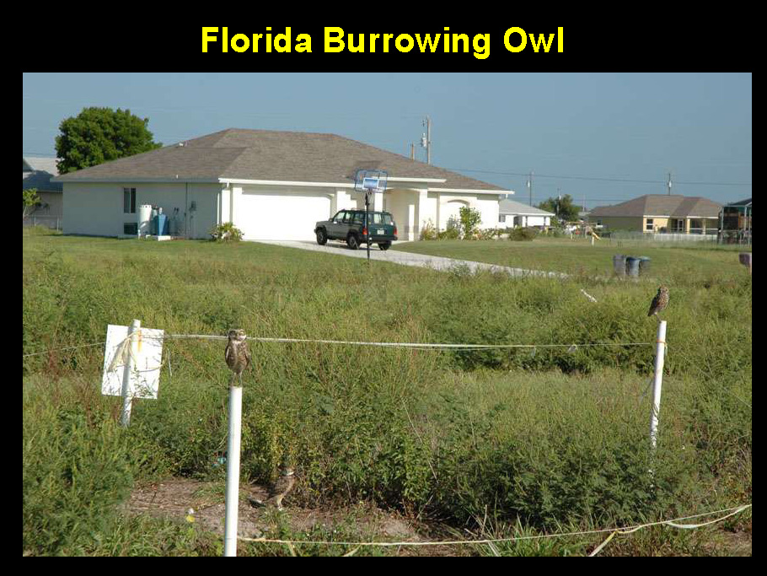
Major Food Item

Slide 9
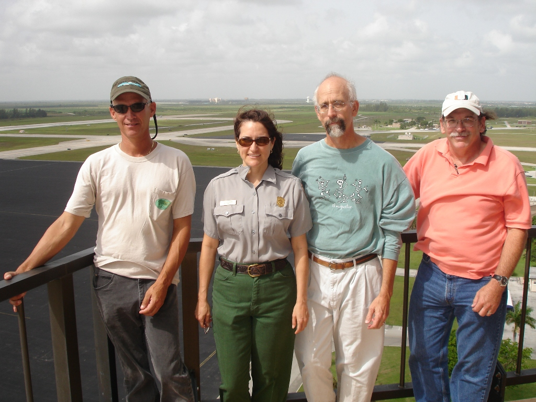
Initial Monitor Lizard Recon Team
NPS
FL/Caribbean Exotic Plant Mgt Team
Biscayne National Park
Everglades National Park
Homestead ARB CEV

Slide 10
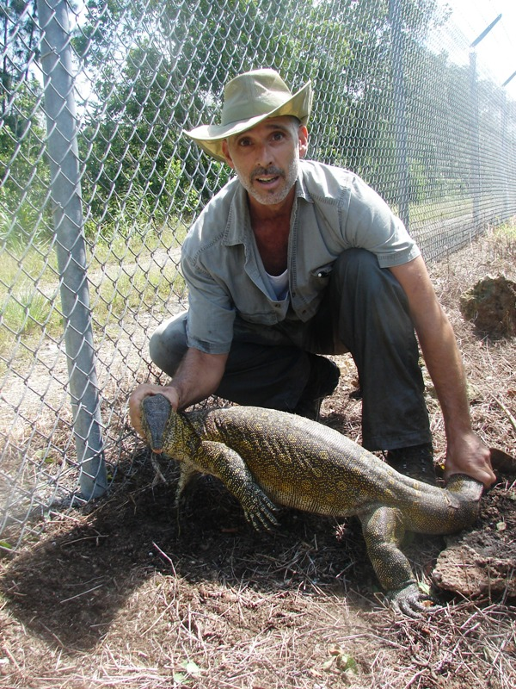
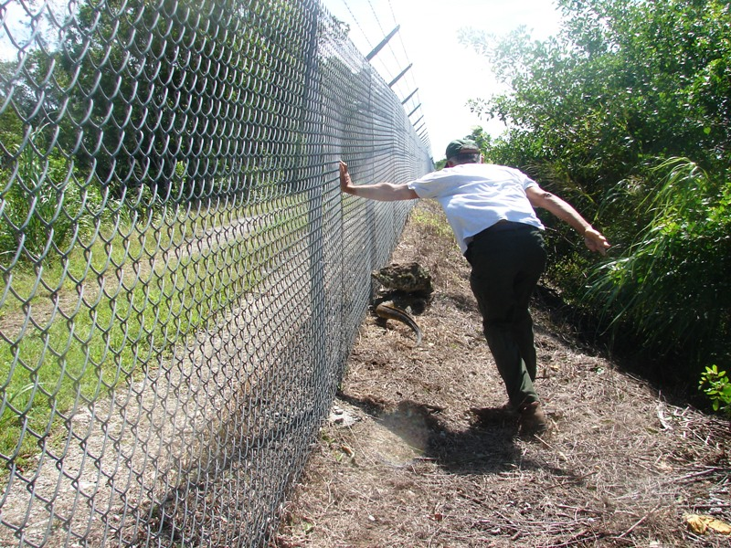
Capture Activities – NPS and FFWCC

Slide 11
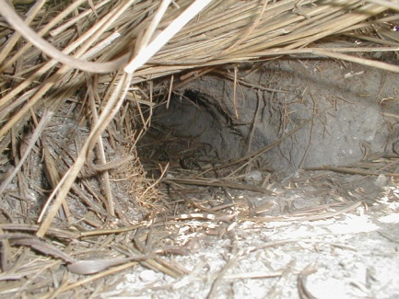
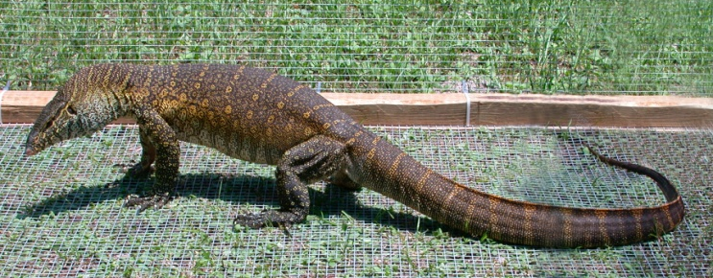
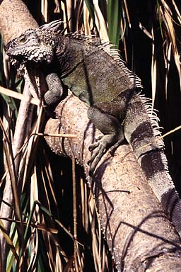
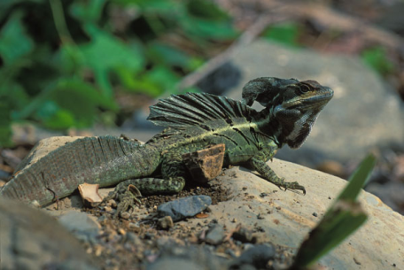
Public Information- Nile Monitor Lizard Flyer
The Nile Monitor Lizard (Varanus niloticus) grows to over 6 ft in length. It is dark brown with yellow spots forming bands around the body of the lizard. It is found near fresh water and its burrows. It can dive under water for up to one hour .It is very agile both on land and in the water. This carnivorous reptile is not native to Florida and poses a danger to Florida’s wildlife. Biologists with the National Park Service are looking for information on sightings of the Nile monitor lizard or its burrows. Please call the Nile Monitor hot line if you have information.
(305) 753-3557
Thank you for calling the Nile Monitor hot line.
Nile Monitor Lizard
Burrow
Iguana – to 6’ in length, herbivorous.
Please do not report sightings
Basilisk – to 2 ft in length, insectivorous, found near water . please do not report

Slide 12
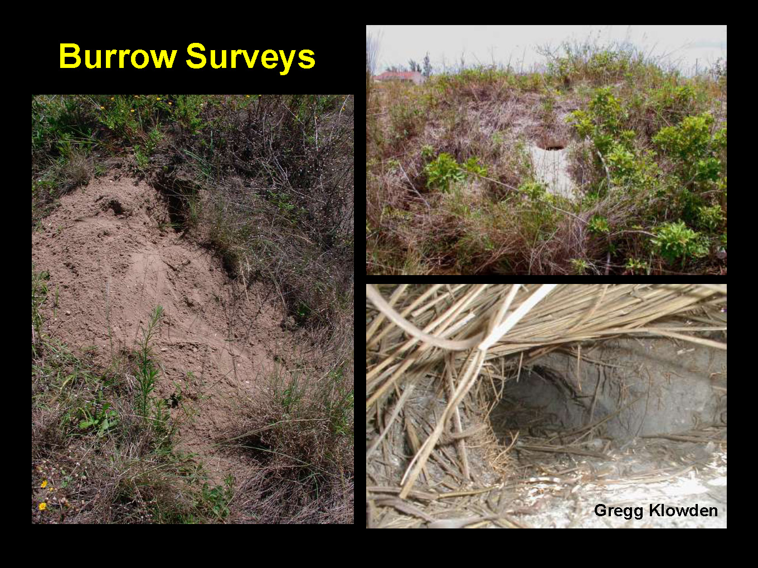

Slide 13
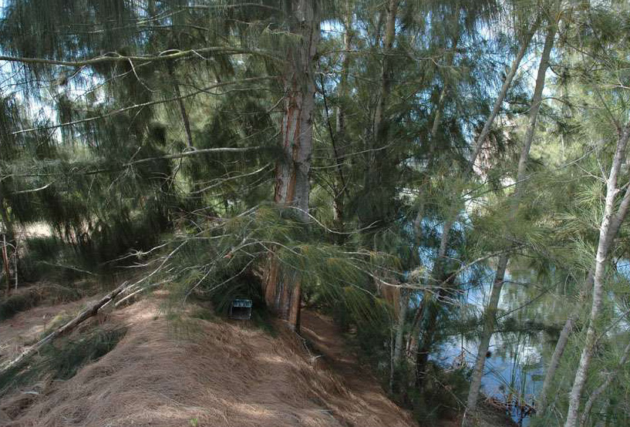
Trapping

Slide 14
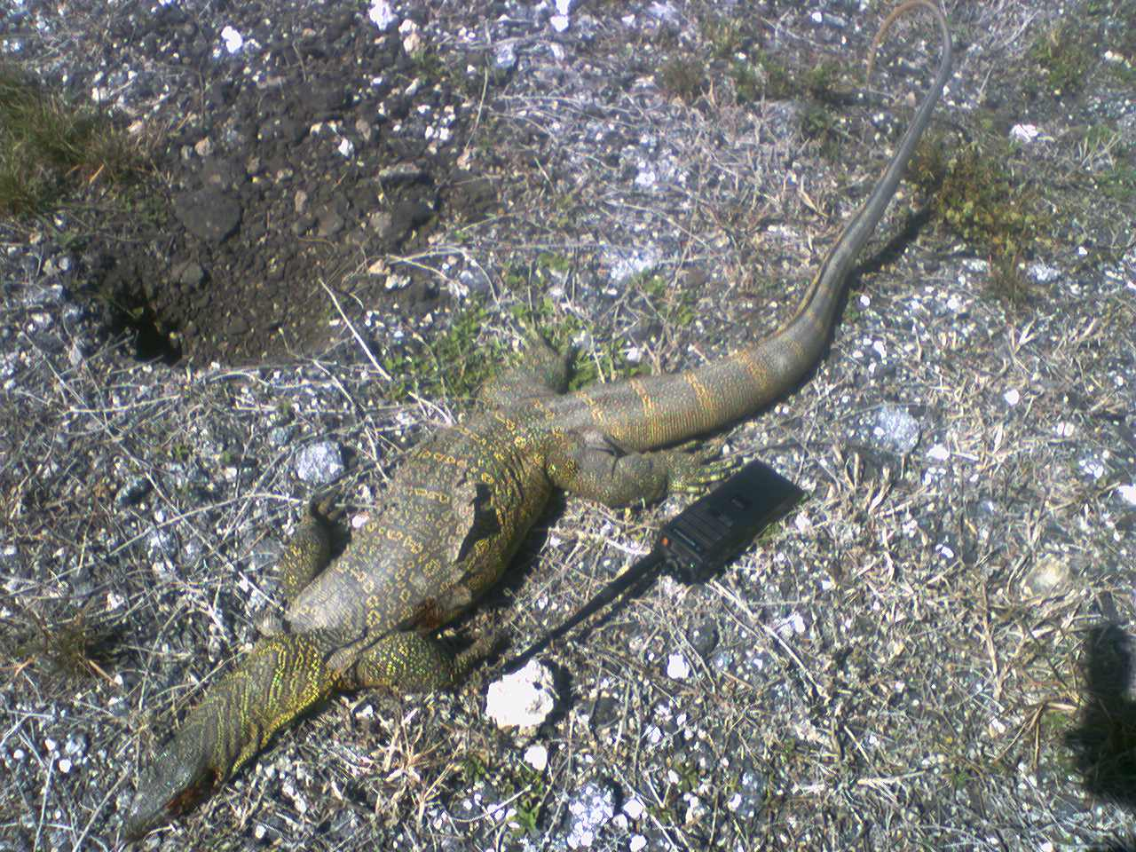
BASH – Permitted Predation

Slide 15
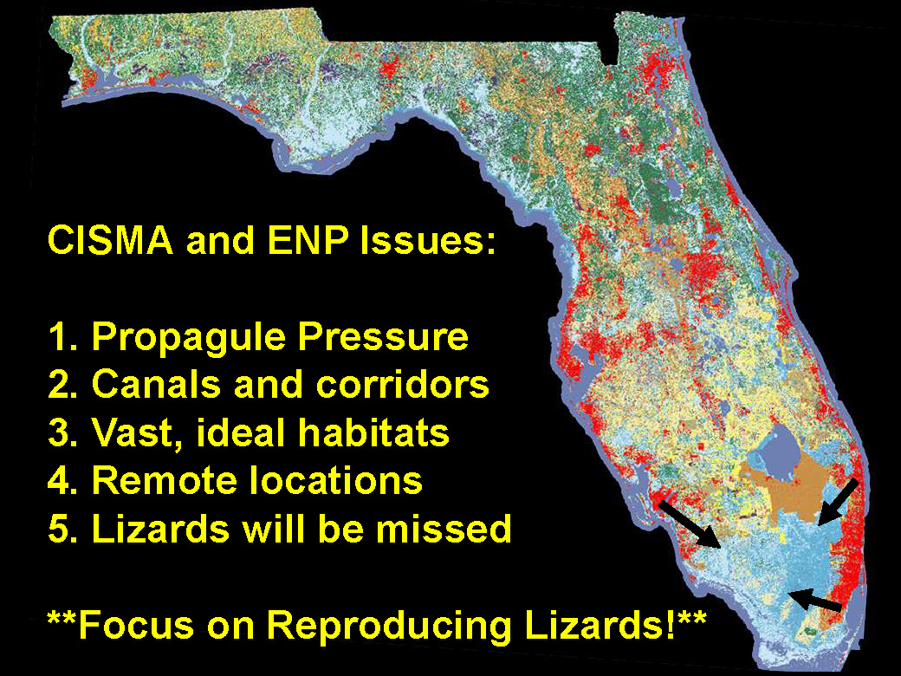

Slide 16
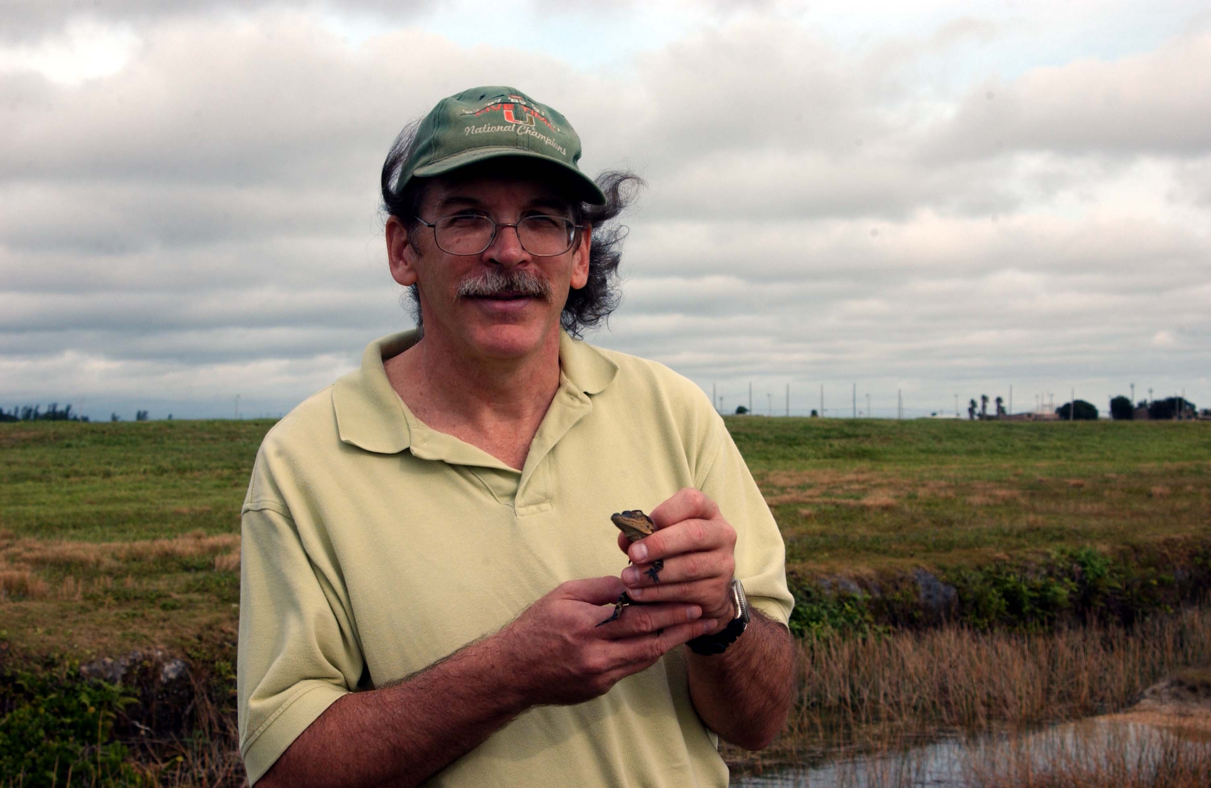
Questions for the “Beast Master”?

